Slide 1
Distributed Computing

Slide 2
What is Distributed Computing ?
Field of computer science.
Components are located on different networked computers.
Communicate and coordinate their actions by passing messages to one another.

Slide 3
Why Distributed Computing is Important ?
Make it easy for users and applications to access.
Resources can be
Peripherals.
Storage facilities.
Data.
Files.
Services, and Networks.

Slide 4
Distributed Computing Concept
Processors
Memory
Disk
Typically the Computing unit
Typically RAM
Typically SSD and HDD

Slide 5
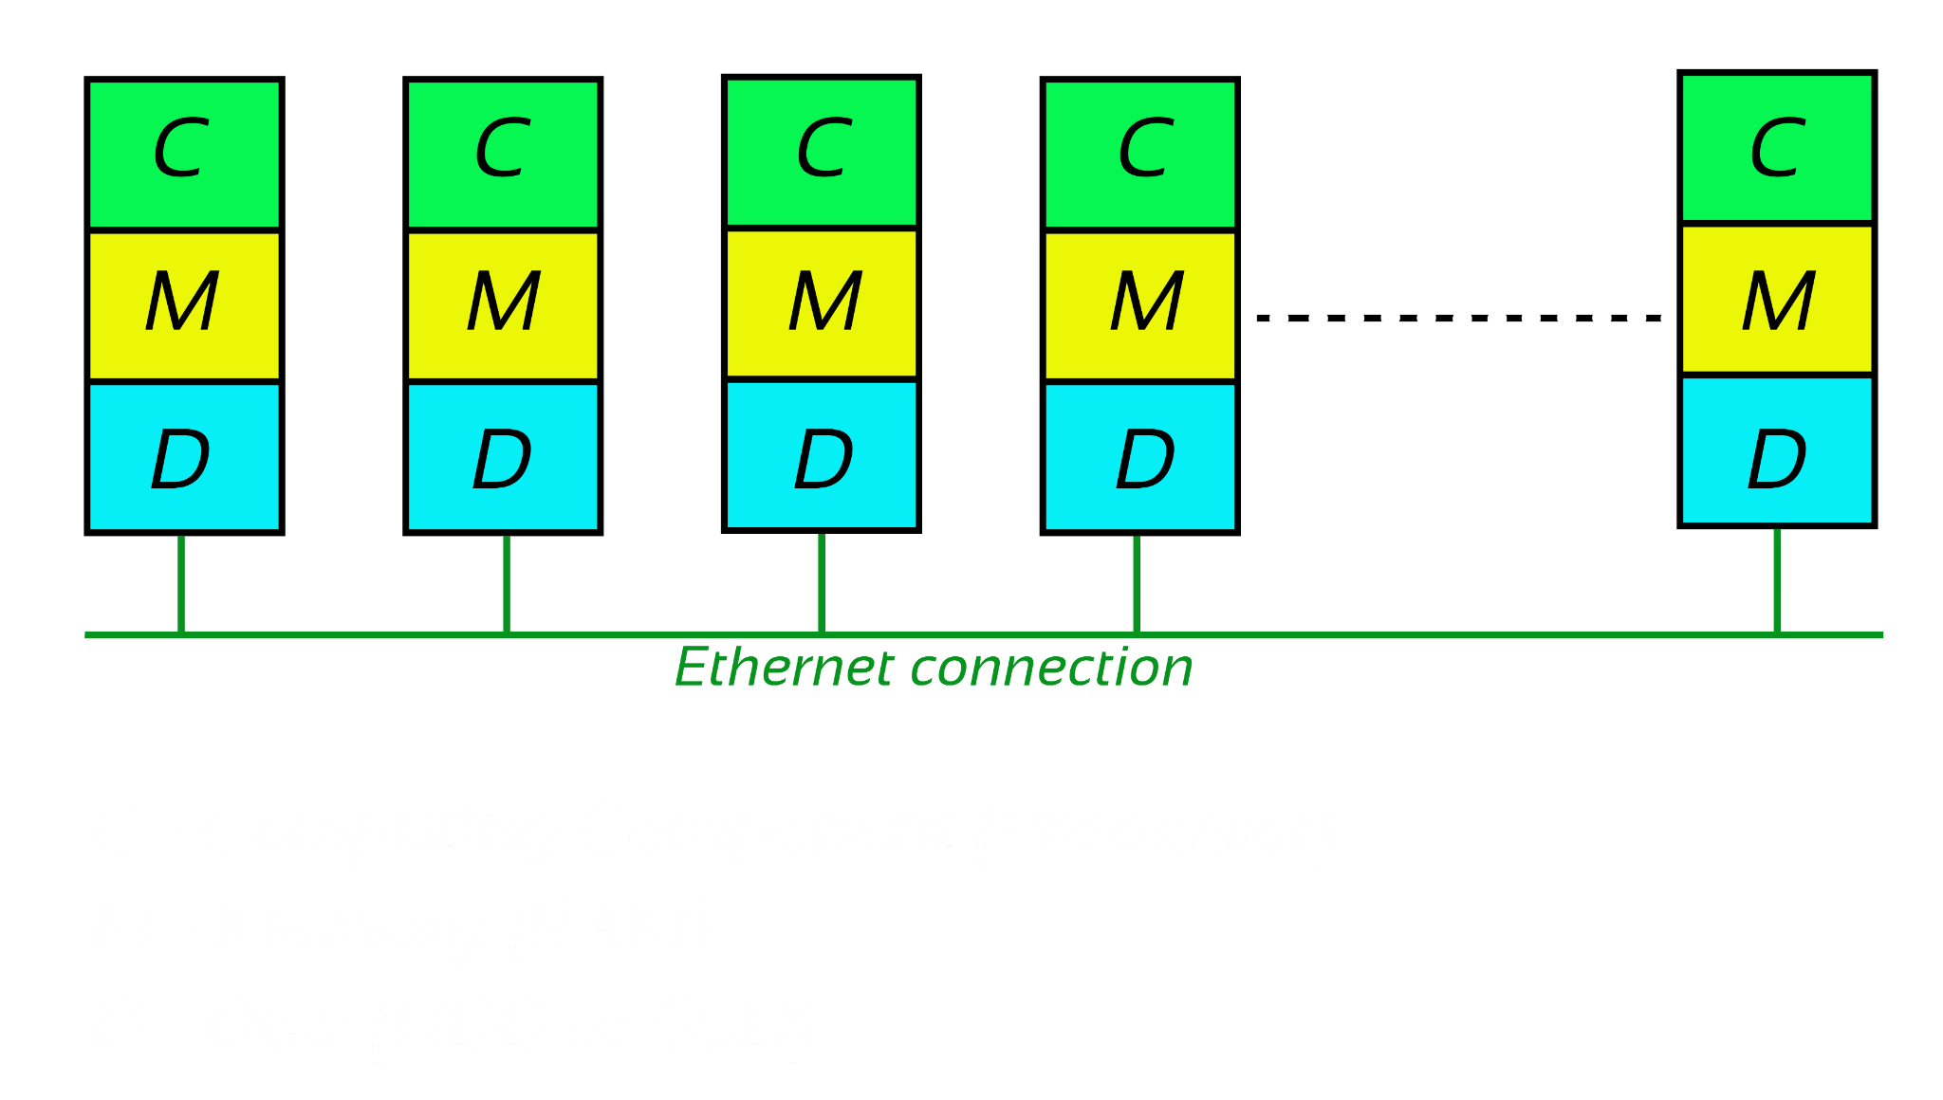
Distributed Computing Concept

Slide 6
Distributed Computing Concept
Distributed computing is all about taking on a large task
Machine learning model on billions of data points
Before 2006
MPI - Message Passing Interface
Around 2006
Hadoop
Became very popular
Much more easier to use than MPI
Around 2013
Spark
Today in 2021
Spark is the most popular choice

Slide 7
Recap
IN THIS LESSON
Distributed systems
How it works
Historical overview of distributed system
IN NEXT LESSON
Overview of Hadoop, HDFS, Map-Reduce
Disadvantages of Hadoop

